Slide 1
VISUAL EMOTION RECOGNITION USING DEEP NEURAL NETWORKS
ALEXANDER ILIEV
AMEYA MOTE

Slide 2
PROBLEM STATEMENT :
Based on pre-existing facts, humans perceive emotions based on a set of facial rules.
Information derived from the emotions are used to understand state of the speech communicated.
Recognizing emotions plays a pivotal role as depending upon emotions, we can decide the context of the speech.
But, the datasets used to identify speech were created in an artificial environment which often does not mirror the real world.

Slide 3
PROBLEM STATEMENT :
It is well documented that facial features also play an important role to identify emotions.
For eg: Raised eyebrows with open mouth expresses surprise whereas slightly curved lips express sadness.
This added information might help identify emotions much better and thus forms the base of this paper.
For this paper, eINTERFACE’05 dataset was used and then converted into a series of images.

Slide 4
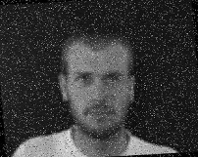
DATASET DESCRIPTION :
As explained, images created in a real world environment would give our model a better chance to identify emotions across various facial images.
For this purpose, some noise and inversion was introduced inside the images.
The images were also changed to monochrome as it would offer our model a better chance at high accuracy.
Thus, a unique dataset was born out of pre-existing dataset.

Slide 5
DATASET DESCRIPTION :
The image shows the distribution images across train, test and validation.
To make sure the model learns in the intended way, the dataset was made balanced.
Utilizing Paul Eckman’s idea of emotions, the paper takes into consideration the following emotions for the purpose of its experiments.
Happiness
Anger
Sadness
Disgust
Fear
Surprise

Slide 6
SYSTEM HARDWARE:
The entire project was taken up on Google Colab. This ensured, the local system was not under-pressure to the amount of images used and also gave security from project getting deleted.
To ensure the model trains faster, Colab’s inhouse GPU called Nvidia K80 was used. On a free-subscription, users can utilize this GPU upto 12 hours a day.
Due to the size of images being considerably larger, they were stored inside Google Drive. This also helped us to directly call them during the training of model instead of uploading them everytime.

Slide 7
NEURAL NETWORK ARCHITECTURE:
To train on the images, it was decided to use Convolutional Neural Network
CNN understands smaller details of each image and works better than artificial neural network
Historically, CNN has been used to identify various pattern across images.
After a series of experimentations, a conclusion was made on the number of hyper-parameters and layers to be used..

Slide 8
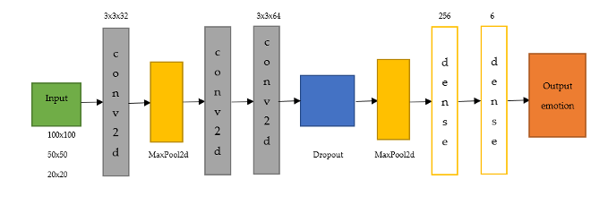
NEURAL NETWORK ARCHITECTURE:
This image shows the architecture in detail
2 conv2d layers along with one maxpooling layer was used so that the model can understand the image better and can classify only the important points on each image
For all the hidden layers, ReLU was used as an activation function. Since the output was in terms of 5 different classes, Softmax activation function was employed at the output layer.
To overcome overfitting, Dense layer ensured that some of the inputs are dropped out of the model.

Slide 9
NEURAL NETWORK ARCHITECTURE:
In order to test the performance of the model, 2 factors were considered.
Accuracy score
Computation time
To test the model under various circumstances, 3 different size of images were considered.
100x100
50x50
20x20

Slide 10
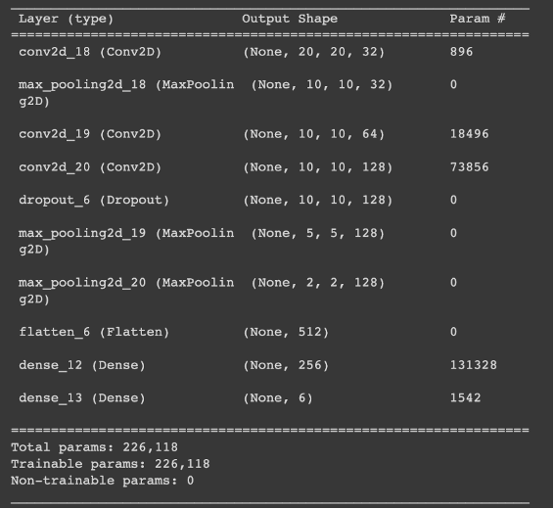
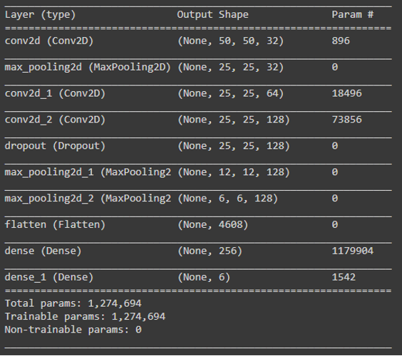
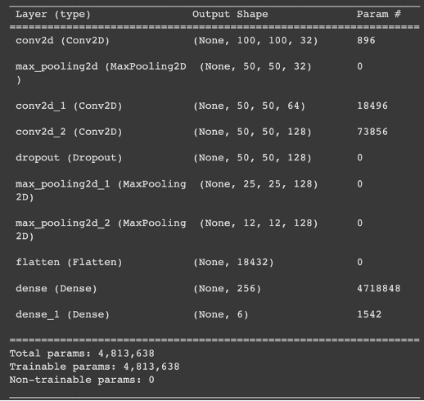
CASE STUDIES:
20 x 20
50 x 50
100 x 100

Slide 11
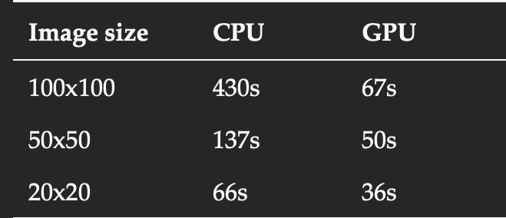
RESULTS:
Before conclusions could be made on the performance of the model, it was to be seen how the model reacts to CPU vs GPU.
This table shows the computation time for each of the system across different image sizes
It can be observed that GPU offers the least computation time across each image.
Thus going forward, all observations were done with the help of GPU.

Slide 12
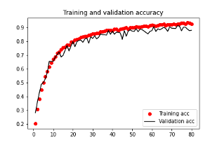
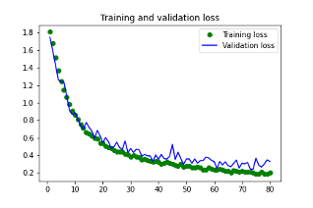
1. 100x100 Image Size
This image size had the highest computation time with 74 mins.
Alternatively, it also had the highest test accuracy of all images with ~91% and a train accuracy of 96%
So, while the model comprises on time, it does not so on accuracy.

Slide 13
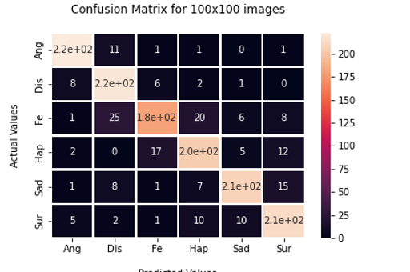
100x100 Image Size
Confusion matrix helps us to understand how well does the model differentiate between different emotions in terms of correlation
The low numbers on the matrix are evident to the fact that model easily distinguishes between different emotions.
The model can also identify each emotion separately. Although a slight change can be seen for the Fear emotion.

Slide 14
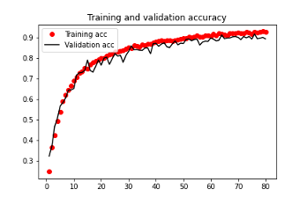
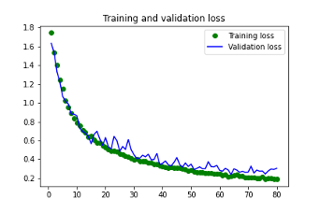
2. 50x50 Image Size
This image size has the computation time of 55 minutes.
It achieved a test accuracy of 87% and a train accuracy of 94%
The model performed better for 50x50 than 100x100 in terms of computation time while also not comprising much on accuracy

Slide 15
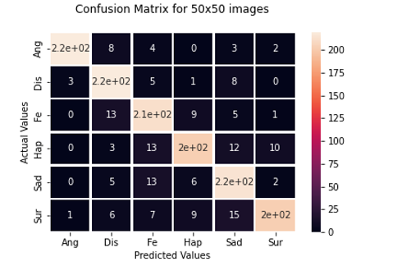
50x50 Image Size
Looking at the confusion matrix, it can be said that as the image size decreases, the model starts finding it difficult to classify emotions
Although slightly, happiness and surprise is not as easily recognised by the model compared to other emotions
The model is able to differentiate each emotion from other emotions easily.

Slide 16
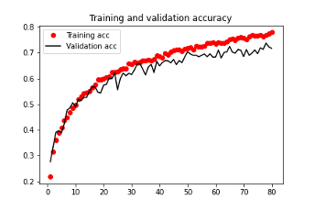
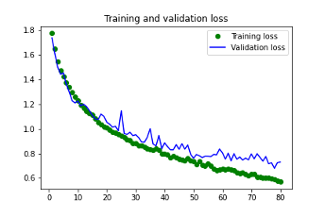
3. 20x20 Image Size
This image size has the computation time of 55 minutes.
It achieved a test accuracy of 72% and a train accuracy of 78%
The model performed better for 50x50 than 100x100 in terms of computation time while also not comprising much on accuracy

Slide 17
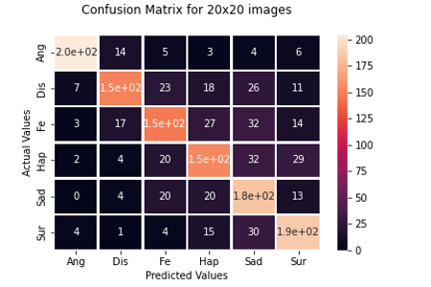
20x20 Image Size
The model fails to identify Disgust, Fear and Happiness much more closely followed by Sadness and surprise.
The model also fails to distinguish different emotions from each other.
Anger is the most distinguishable emotion amongst other emotions.

Slide 18
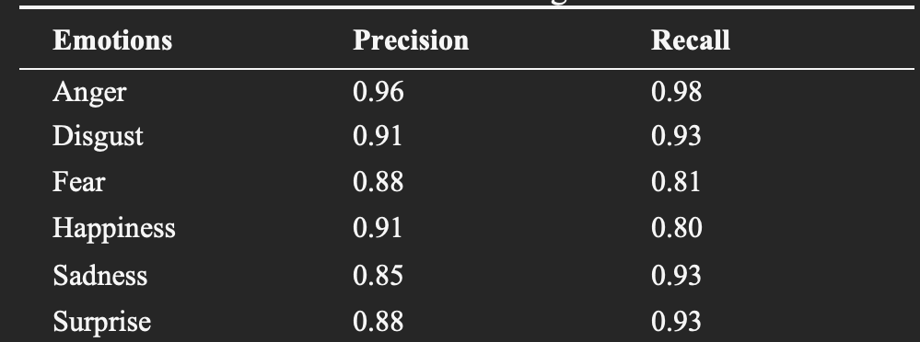
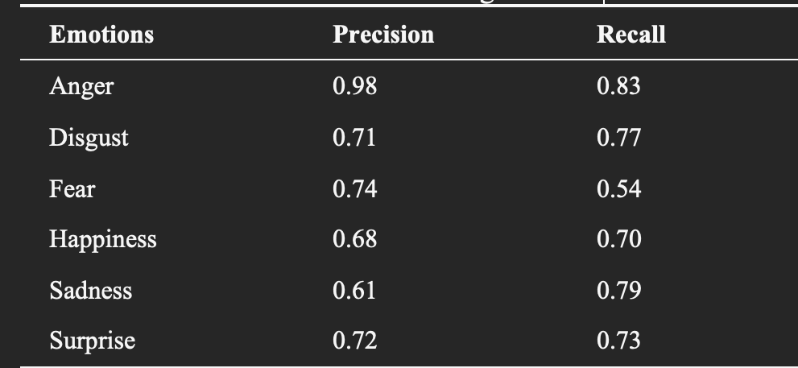
PRECISION AND RECALL METRICS
While 100x100 image size has the highest accuracy among other sizes, the computation time ensures such a size cannot be used in environments where time is important.
Thus for this part, we have only included 50x50 image and 20x20 image sizes for comparison.

Slide 19
CONCLUSION:
Globalization has led to vast exchange of ideas and information across the whole world.
Understanding each other is very important to ensure successful communication
This paper tries to ensure there is a common ground for expressing emotions by analysing various facial features.
Since in a real world, the image might not be perfect everytime, we try to prepare our model by introducing image augmentation techniques.

Slide 20
CONCLUSION:
100x100 image size gives the highest accuracy and the highest computation time. 20x20 image size offers the least accuracy and the least computation time
Thus, not willing to compromise much on both, for future purposes, 50x50 image size should be considered.
Observing emotions, Anger is the most easily perceived emotion with Surprise being difficult to perceive.
Next steps should include adding speech to images and observing if there is any chance in the performance metrics.

Slide 21
THANK YOU

