Slide 1
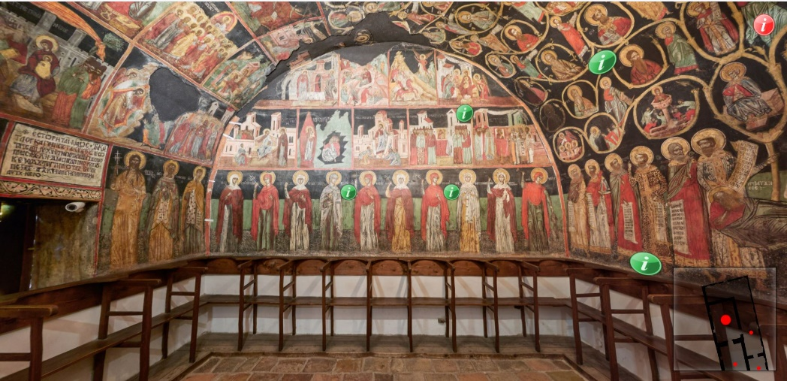
Virtual Walk in the Church of Nativity in Arbanasi
Zsolt László Márkus, Tibor Szkaliczki, György Szántó, Miklós Veres, Zsolt Weisz – eLearning Department of the Institute for Computer Science and Control (SZTAKI)
Detelin Luchev, Desislava Paneva-Marinova, Maxim Goynov, Radoslav Pavlov – Institute of Mathematics and Informatics, Bulgarian Academy of Sciences (IMI-BAS),
Lilia Pavlova – Laboratory of Telematics, Bulgarian Academy of Sciences

Slide 2
Contents
Introduction
Church of Nativity in Arbanasi
Digital Library "Virtual Encyclopedia of Bulgarian Iconography" (BIDL)
Panorama Pictures
Virtual Walks
Integrating Virtual Walks with BIDL in the Church of Nativity in Arbanasi
Evaluation
Conclusions

Slide 3
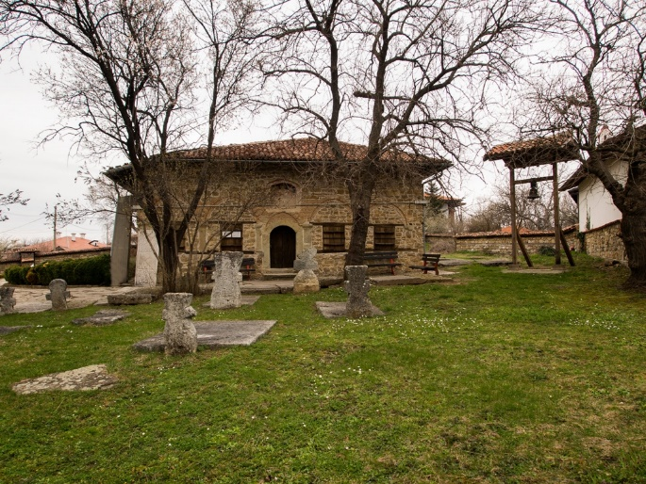
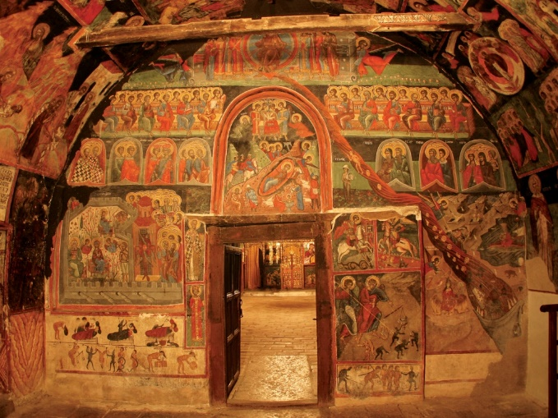
Church of Nativity in Arbanasi
Arbanasi is located near Veliko Tarnovo the former capital of Bulgaria.
Known for its historical monuments and picturesque natural features.
The Church of Nativity of Christ was built in the 16th century.
All walls and vaults (2,000 m2) are covered with painting.
It has a unique mural ensemble in terms of thematic breadth and encyclopedicity.

Slide 4
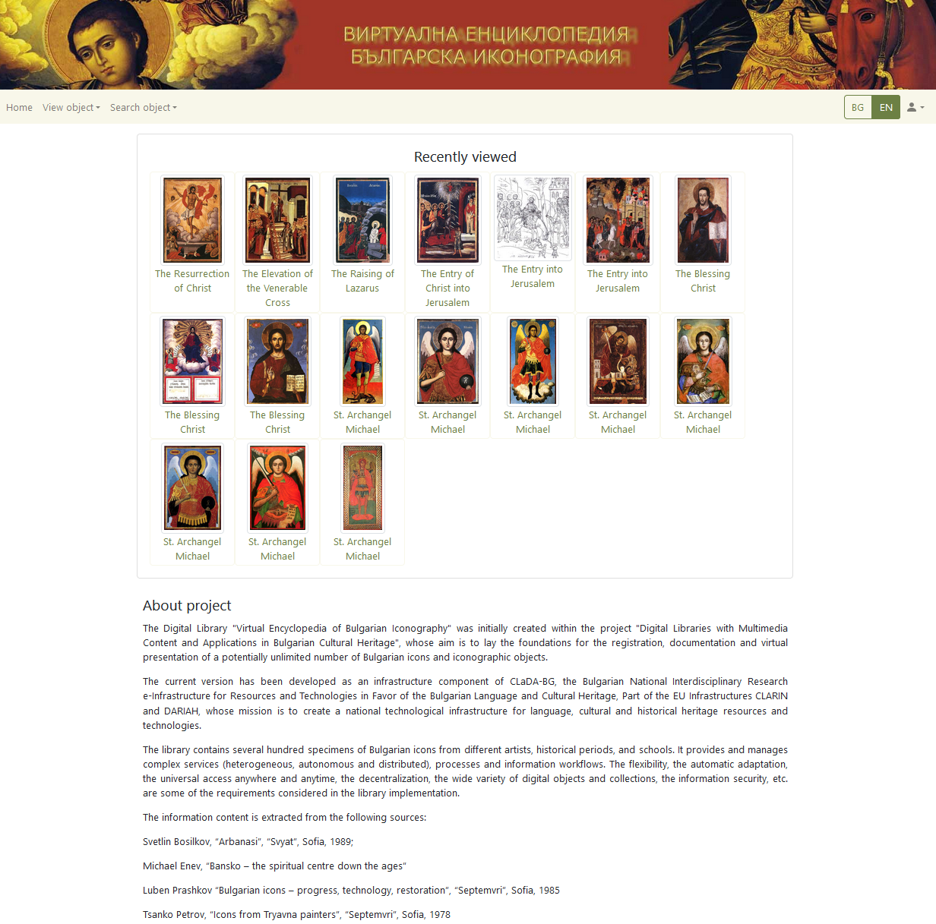
Digital Library "Virtual Encyclopedia of Bulgarian Iconography" (BIDL)
Online web portal http://bidl.cc.bas.bg
Available languages: Bulgarian and English.
An infrastructure component of CLaDA-BG.
It provides complex services, processes and information workflows.
Universal access anywhere and anytime
Notes:
Ikonok a kulturális örökségük fontos eleme az ortodox vallású népeknek. Például jövő héten lesz a DIPP kulturális örökség digitális megőrzés és bemutatás konferencia Bulgáriában, és ott több előadás is foglalkozik az ikonokkkal.
Bulgária különböző részeiből, sőt európai múzeumokban, templomokban, magángyűjteményekben levő ikonok is vannak
12. sz. - 20. sz. elejéig
Különböző ikonfestő iskolák képei.

Slide 5
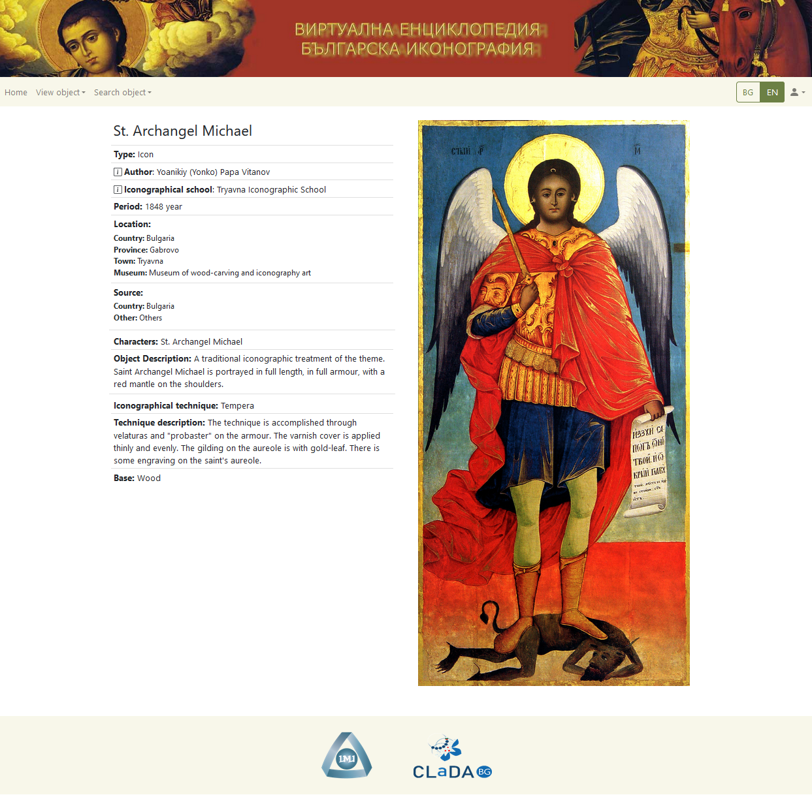
Bulgarian Iconographical Digital Library (BIDL)
Contains hundreds of icons from various centuries
Includes picture
Metadata
Notes:
Ikonok a kulturális örökségük fontos eleme az ortodox vallású népeknek. Például jövő héten lesz a DIPP kulturális örökség digitális megőrzés és bemutatás konferencia Bulgáriában, és ott több előadás is foglalkozik az ikonokkkal.
Bulgária különböző részeiből, sőt európai múzeumokban, templomokban, magángyűjteményekben levő ikonok is vannak
12. sz. - 20. sz. elejéig
Különböző ikonfestő iskolák képei.

Slide 6
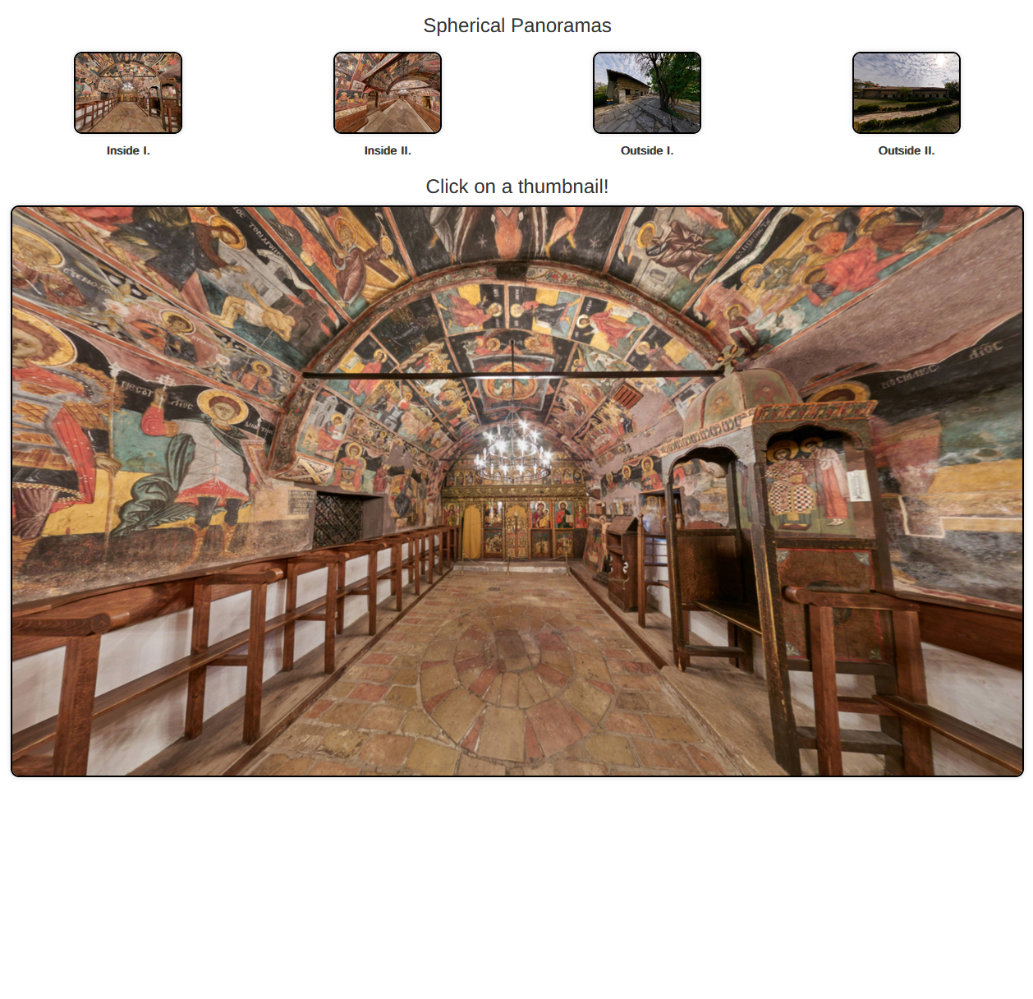
Bulgarian Iconographical Digital Library (BIDL) – Panoramas
Extending the Web page with a new section containing panoramas on the selected church(es) in Arbanasi and/or Veliko Tarnovo:
Church of the Nativity
Peter Paul Ivan Rilski
Church of Ss. Archangels Michael and Gabriel
Church of St. George in Veliko Tarnovo
Holy Forty Martyr’s church and the Great Laurel Monastic Complex
2-4 panorama pictures belong to each location.
Notes:
Ikonok a kulturális örökségük fontos eleme az ortodox vallású népeknek. Például jövő héten lesz a DIPP kulturális örökség digitális megőrzés és bemutatás konferencia Bulgáriában, és ott több előadás is foglalkozik az ikonokkkal.
Bulgária különböző részeiből, sőt európai múzeumokban, templomokban, magángyűjteményekben levő ikonok is vannak
12. sz. - 20. sz. elejéig
Különböző ikonfestő iskolák képei.

Slide 7
An Overview of Panorama Pictures
An attractive and informative tool to present cultural heritage sites
Categorisation
Virtual panorama
Photo panorama
Types of photo panorama pictures
Cylindrical: to look around in 360 degrees
Spherical: to look around in 360 degrees + top and bottom views
General functions
Zoom in and own
Rotation
Tilt up and down

Slide 8
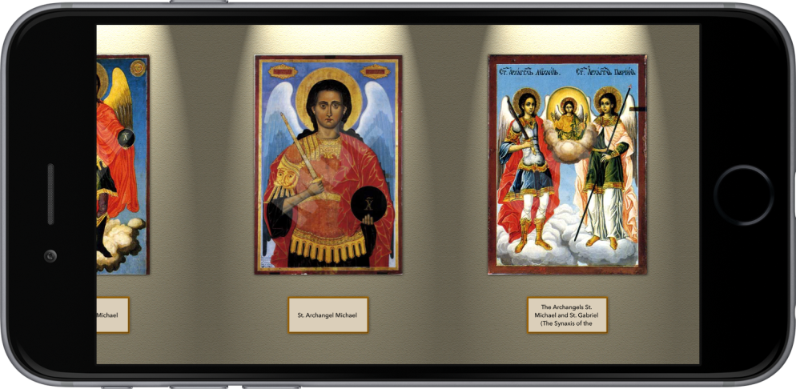
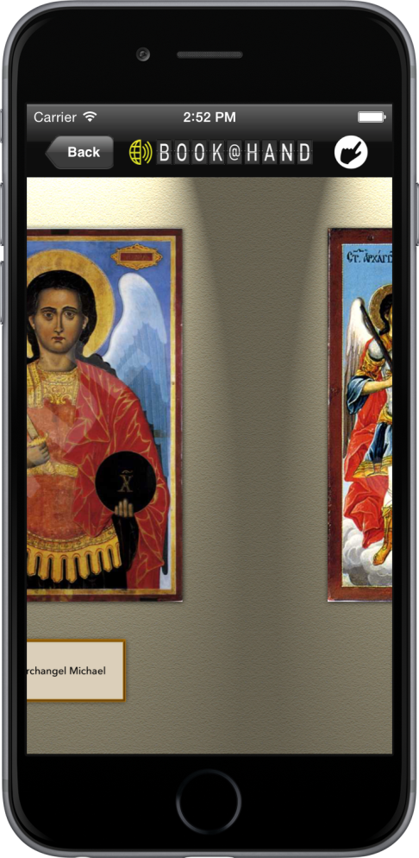
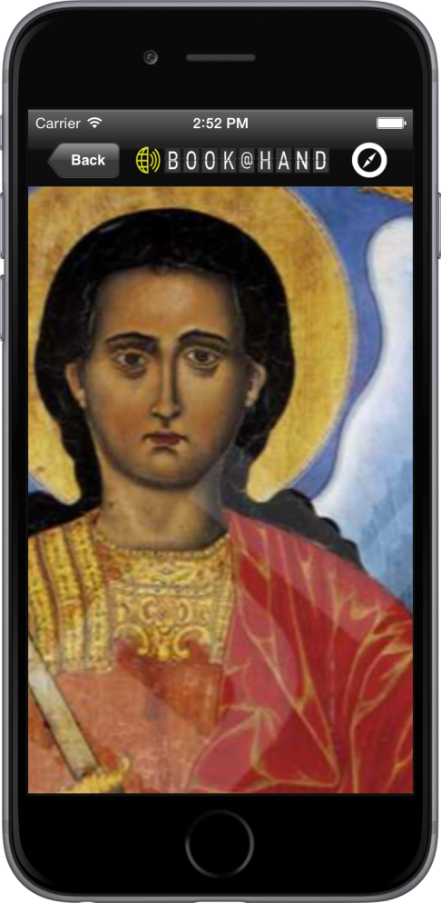
An Overview of Panorama Pictures – Virtual panorama
Generated by the user selected icons of BIDL
Presented by BOOK@HAND BIDL smartphone application

Slide 9
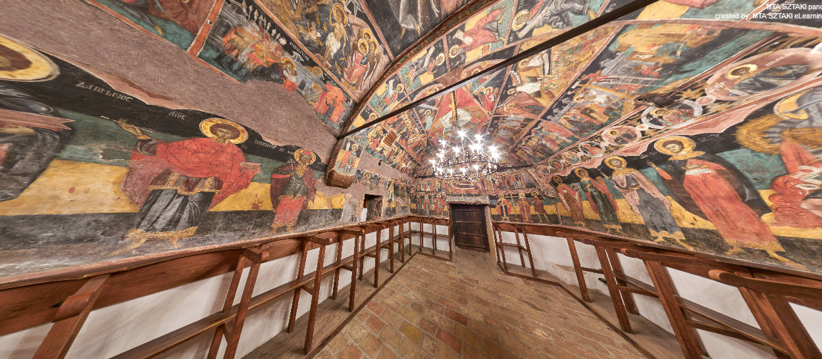
An Overview of Panorama Pictures – A segment of a photo panorama picture
Church of the Nativity, Arbanasi
DIPP2022 - BURGAS, Bulgaria
23-25 September 2022

Slide 10
The Technology of Preparing Panorama Pictures
Options to take photos for panorama pictures:
series of photos while turning the camera with equal angles,
series of photos in several rounds by using an advanced rotator, where the camera is tilt upwards or downwards with different angles in each round,
“normal” camera or “special” camera with built-in panorama picture functionality
Graphical software tools
professional photo editing software tools
panorama stitching software,
transformation to cubic panorama picture

Slide 11
Presenting Panorama Pictures
The panorama pictures can be presented:
on Web-based platforms (the BIDL website, the web site of the relevant sights, Facebook, Google Maps)
in smart phone applications (BOOK@HAND BIDL, GUIDE@HAND Esztergom Vármúzeum)
in a virtual space due to the Virtual Reality (VR) technology with the help of 3D VR glasses
There are two display options in smart phone applications
Automatic: The picture is moved by the device compass and gyroscope sensors.
Manual: The picture is manually moved by the user using swipe gestures.
In both manual and automatic modes the mobile device can be used in both portrait and landscape view.

Slide 12
Panorama viewer of SZTAKI
Functionality
Display full 360° spherical panorama pictures
Offline panorama
Hotspots
Change panoramas from list
Music
High resolution offline images
Zoom
Remote control
Technology
OpenGL, WebGL, Unity

Slide 13
Panorama Pictures Created by SZTAKI in Bulgaria
Churches in Veliko Tarnovo and Arbanasi
Museum of the Bulgarian Revival and Constituent Assembly (Veliko Tarnovo)
Bridges of Veliko Tarnovo
Touristic and cultural sites in Burgas
Ruins of ancient Roman baths in Aqua Calidae – Thermopolis (Vetren)
Ostrusha mound, a Thracian burial tumulus (near Kazanlak)

Slide 14
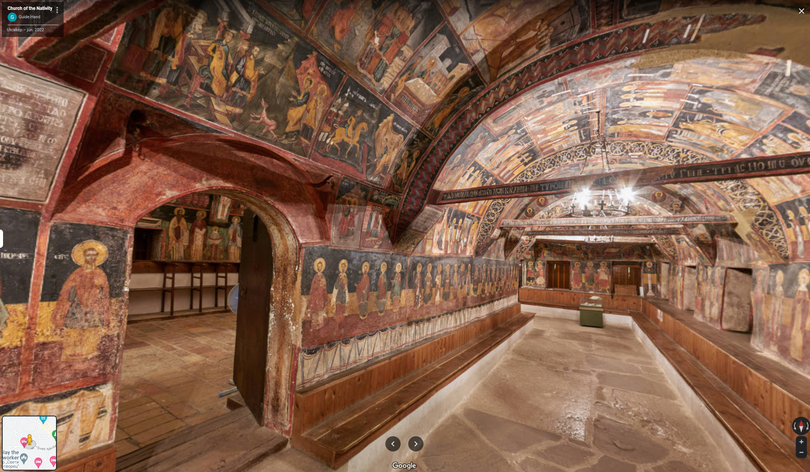
Presenting Panorama Pictures on Google Maps

Slide 15
Presenting Panorama Pictures on Google Maps – Statistics 1
The total number of panorama pictures uploaded by SZTAKI: 104.
The total number of views of panorama pictures uploaded by SZTAKI: more than 4 million.
The number of locations where SZTAKI created panorama pictures in Bulgaria and uploaded them on the Google Maps: 9
The number of Bulgarian panorama pictures uploaded by SZTAKI: 19
The time when SZTAKI uploaded the Bulgarian panorama pictures: June 2022
The total number of views of Bulgarian panorama pictures uploaded by SZTAKI: 250 thousand.
The number of views of Bulgarian panorama pictures in the last month: 75 thousand.

Slide 16
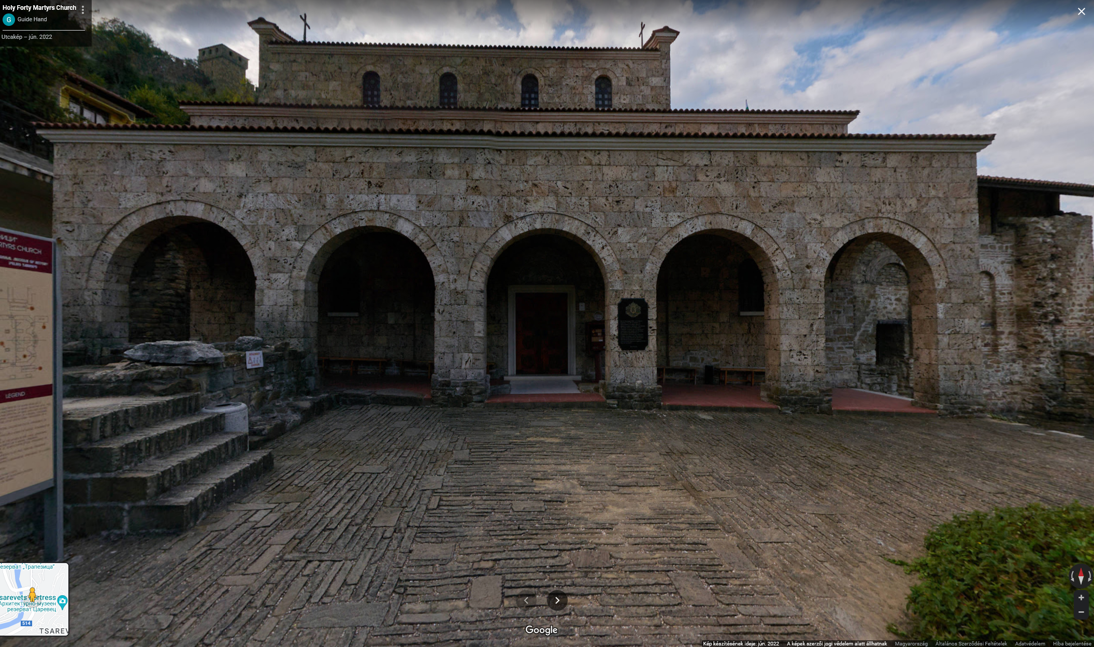
Presenting Panorama Pictures on Google Maps – Statistics 2
Our most popular Bulgarian panorama pictures on Google Maps:
Holy Forty Martyrs Church in Veliko Tarnovo
Church of Holy Archangels Michael and Gabriel in Arbanasi
Saint George Church in Veliko Tarnovo
Holy Forty Martyrs Church

Slide 17
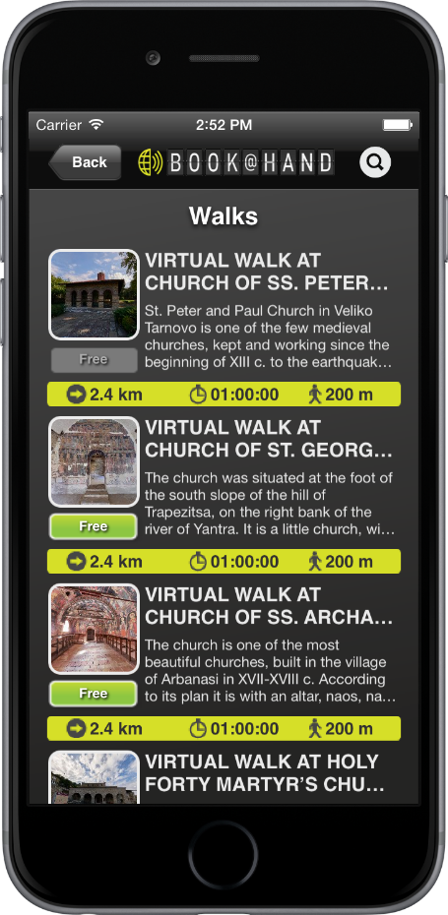
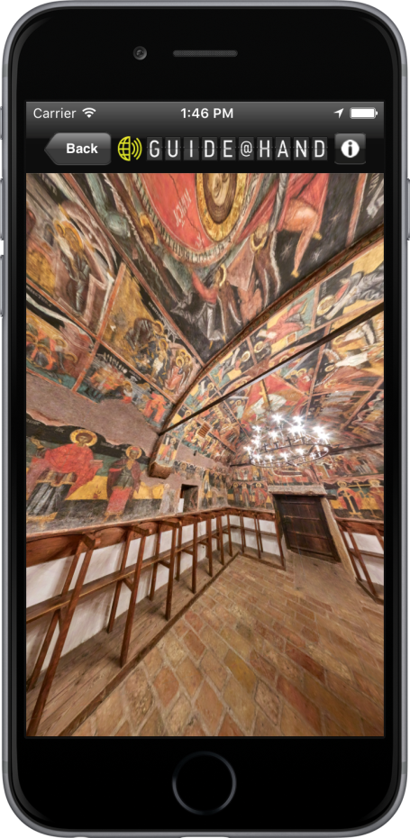
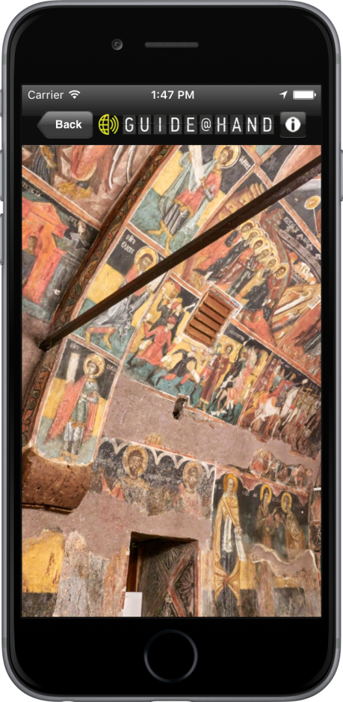
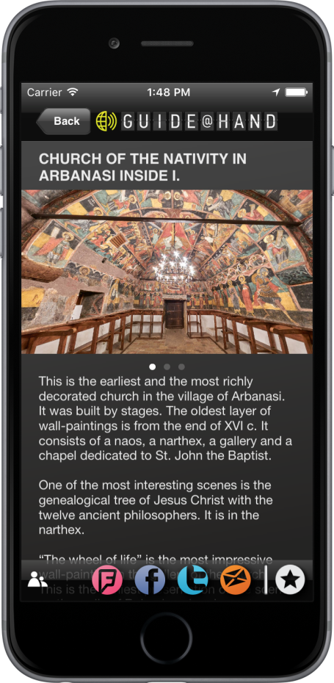
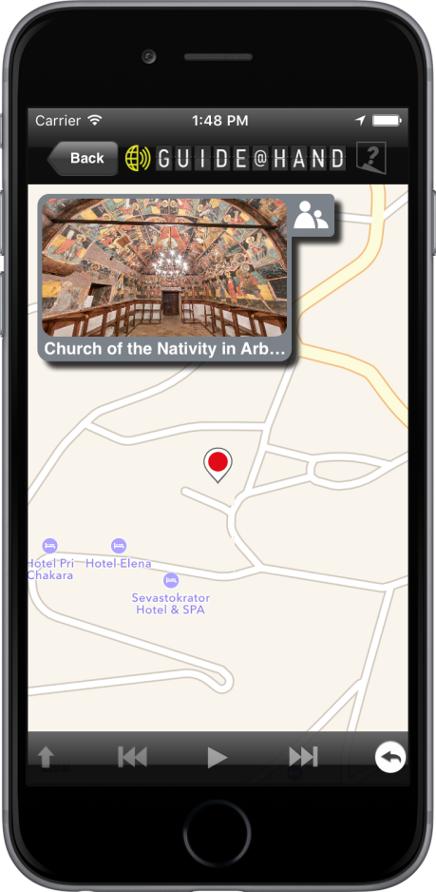
Presenting Panorama Pictures in in the BOOK@HAND BIDL Mobile Application
Panoramas Picture1 Picture2 Description Offline map

Slide 18
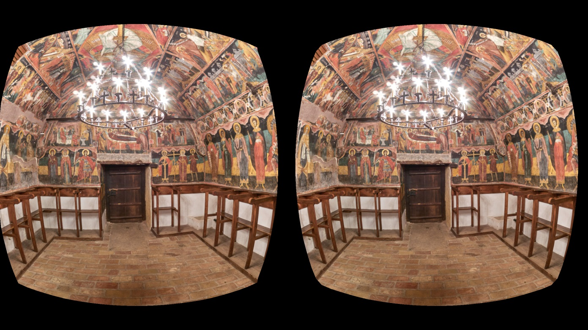
Presenting Panorama Pictures in 3D VR glasses
Hardware: Samsung Gear Headset, Samsung Galaxy S7 smart phone

Slide 19
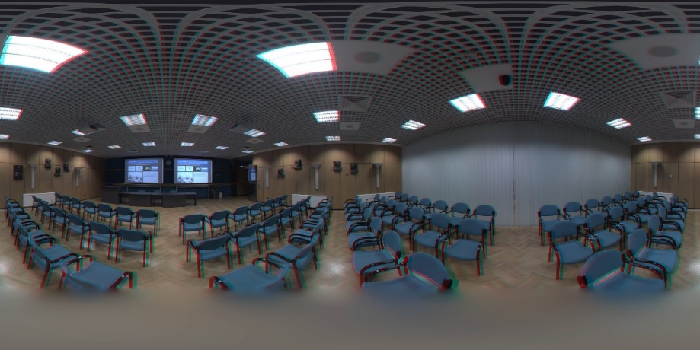
Virtual Walks
A service to present, virtually walk around and interactively explore real spaces and special environments.
High-resolution, real 2D or 3D and 360° spherical panorama pictures are taken of the target spaces.
These pictures are embedded into Virtual Walks by our own developed Content Editor Tool.
The Virtual Walk can be accessed via a multiplatform (Web, mobile, VR) player on various devices.

Slide 20
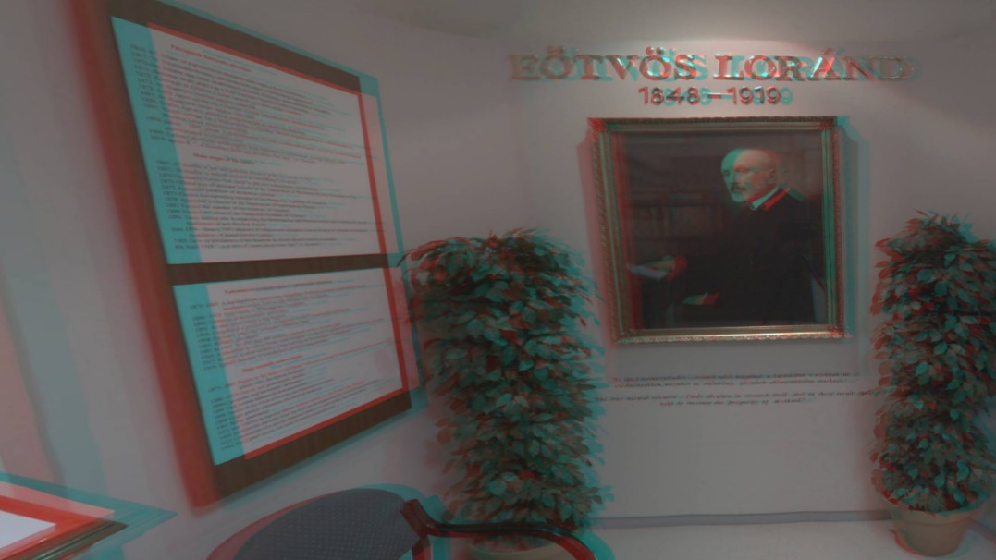
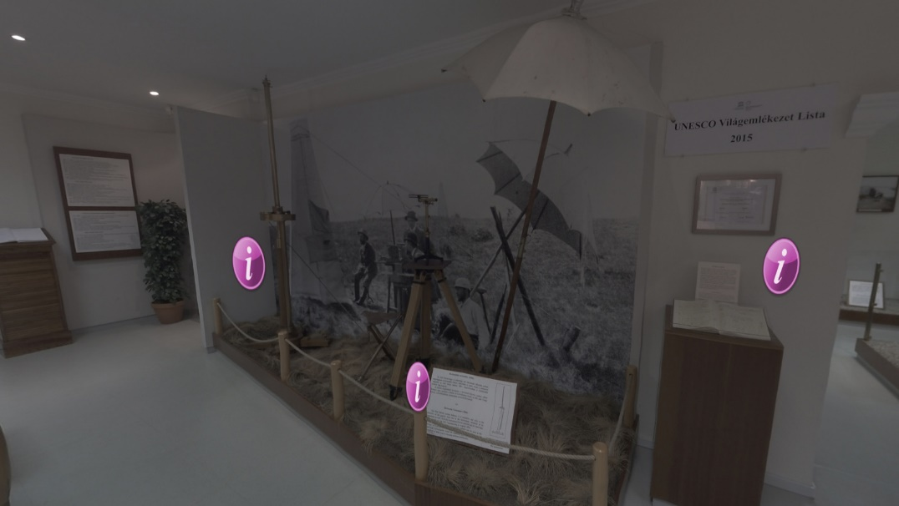
Virtual Walks – in 3D and 2D
Location: Mining and Geological Survey of Hungary
2D interactive version with additional information
3D anaglyph

Slide 21
Virtual Walks – Applications
presenting locations hard to reach,
presenting environments requiring special clothing or imposing strict local rules,
presenting locations where persistent work largely restricts visits,
presenting temporarily available contents,
adding multilingual, complementary multimedia contents to present real environments in a more detailed, diverse and novel way,
exploring remote locations from a distance,
…

Slide 22
Virtual Walks – Functionality
It preserves the functions of panorama pictures.
Additional functions and components:
Moving forward / moving backward
Changing viewpoint / changing image
Minimap
Directions

Slide 23
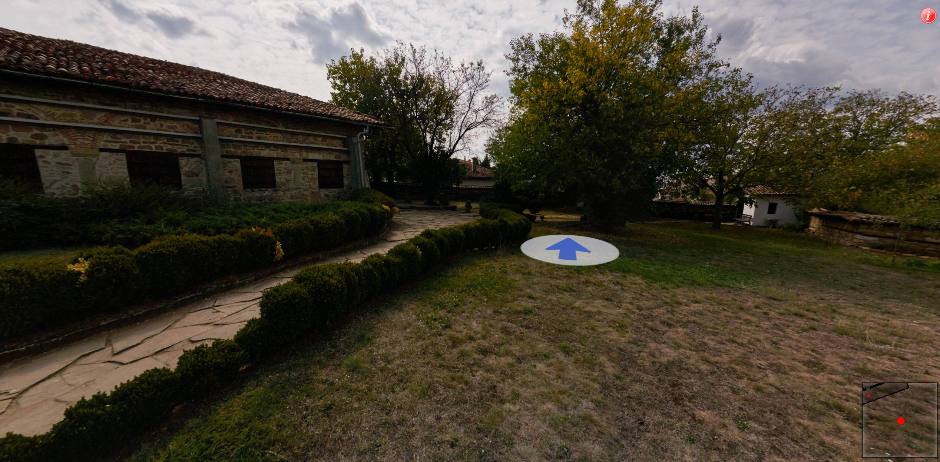
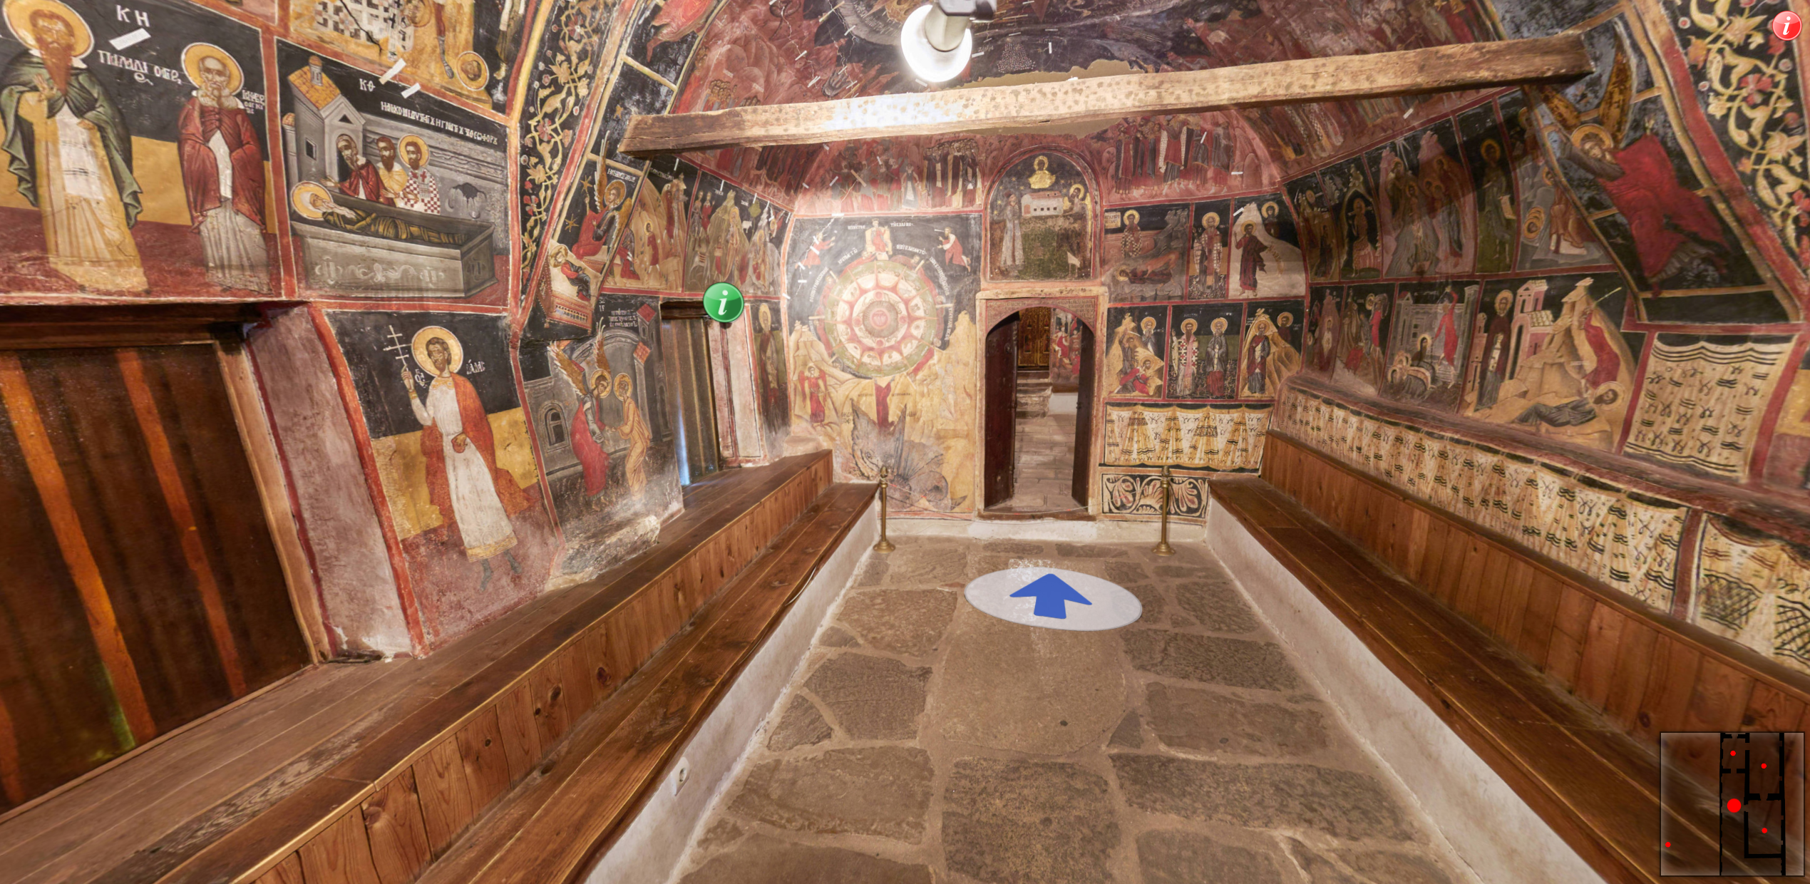
Virtual Walks in the Church of Nativity in Arbanasi
Created from existing panorama pictures
outdoor
indoor

Slide 24
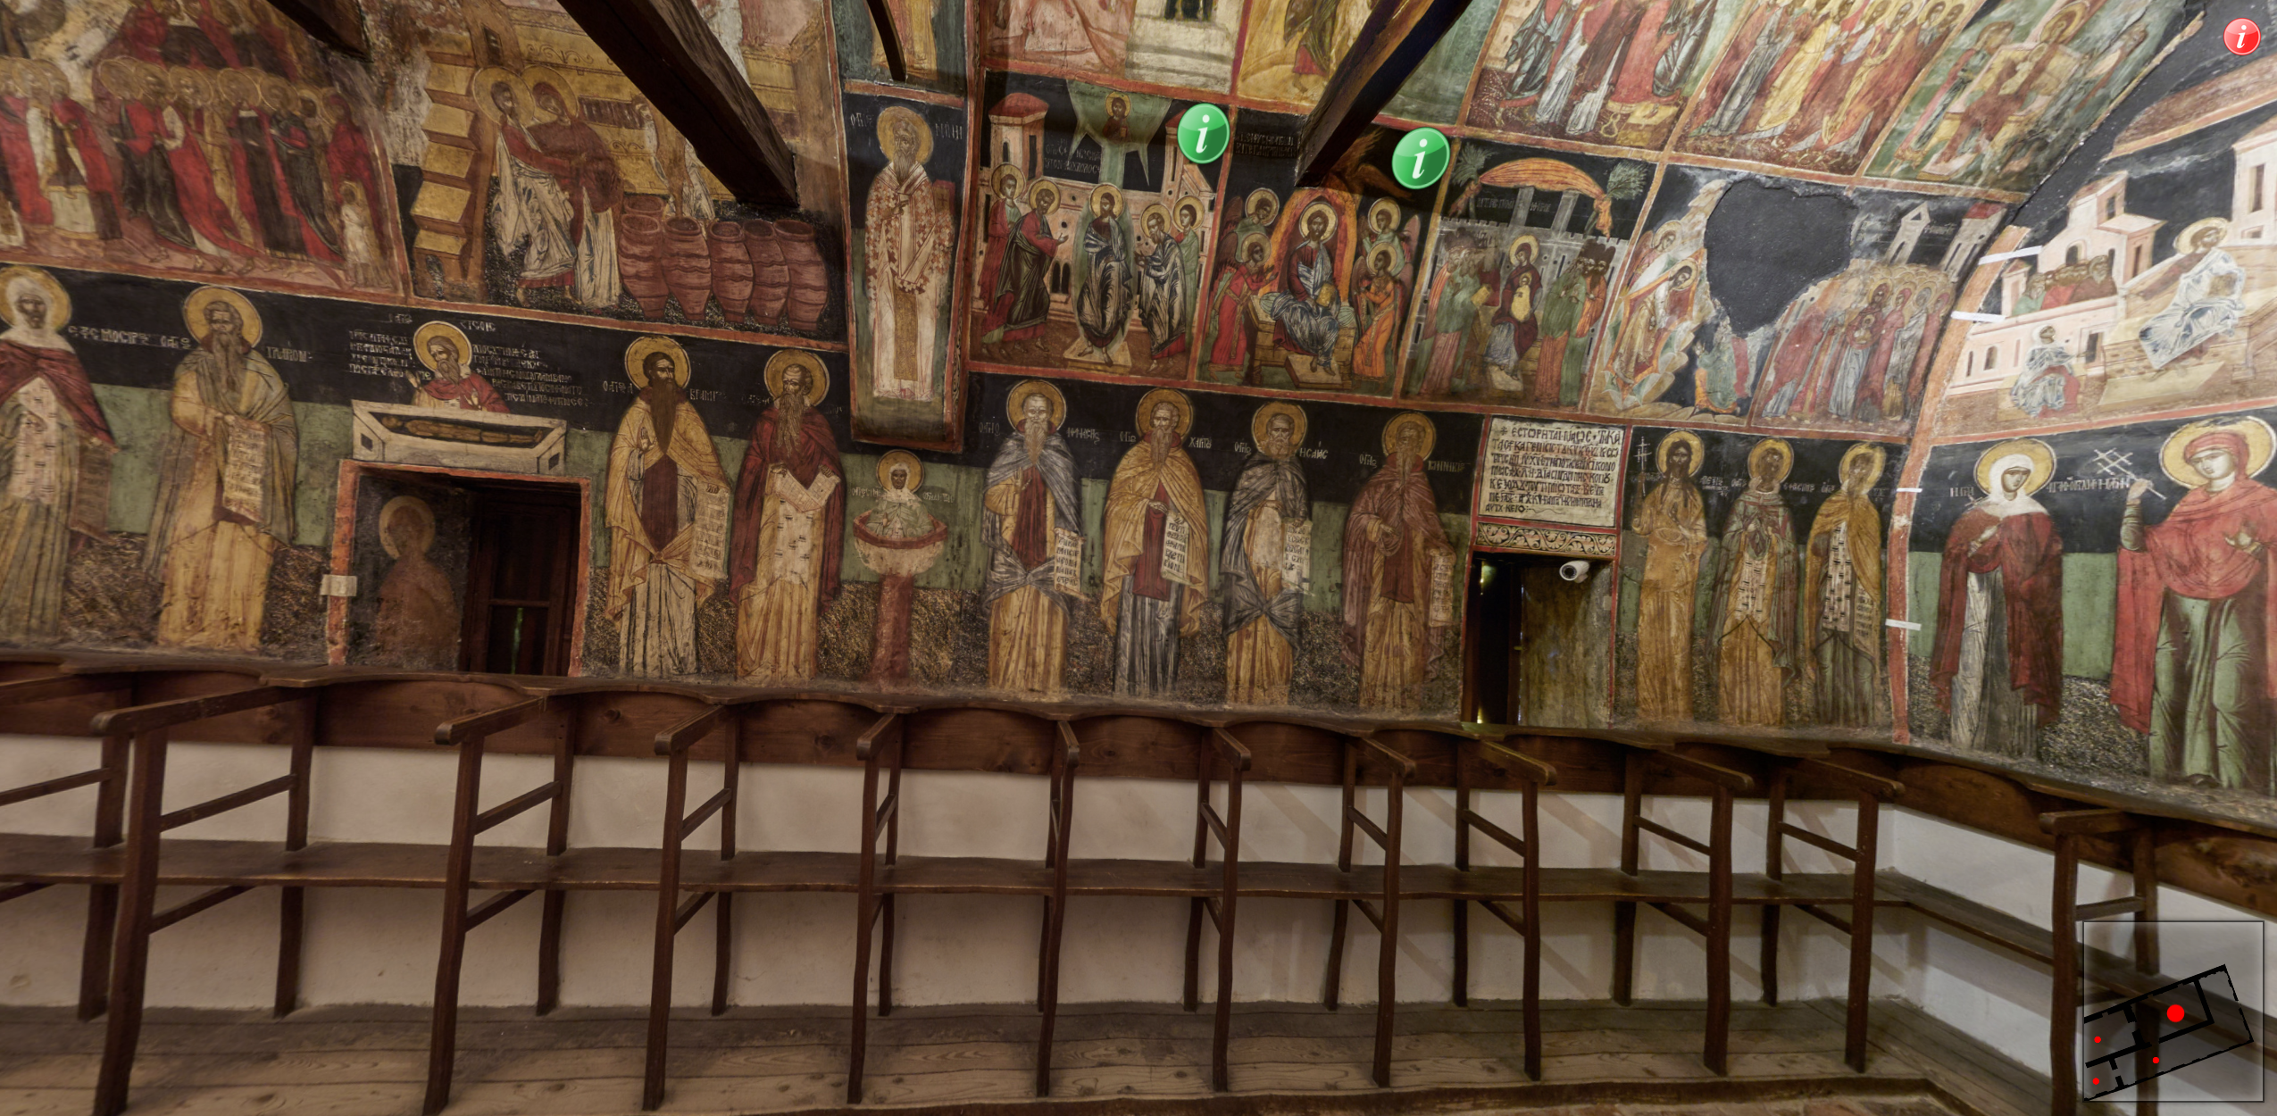
Visiting the Church of Nativity in Arbanasi

Slide 25
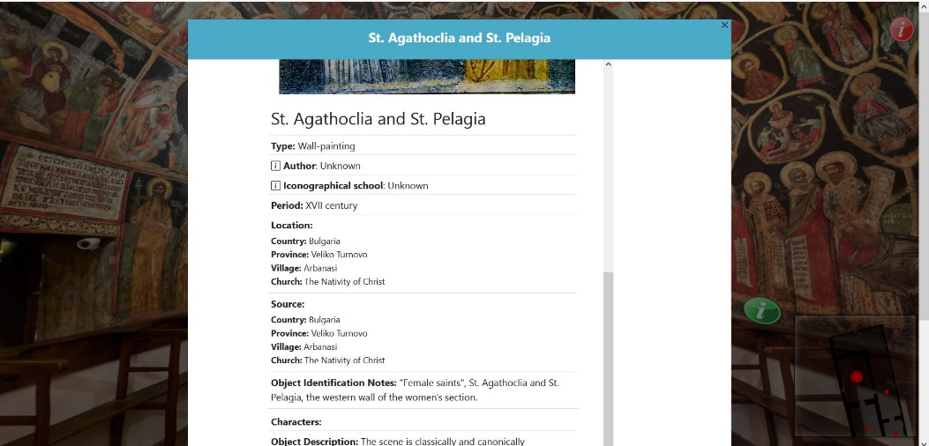
Integrating Virtual Walks with BIDL
Hotspots are placed at selected icons and they are linked to the BIDL.
By clicking on a hotspot, the image and description of the icon in BIDL is online presented in Bulgarian and English.

Slide 26
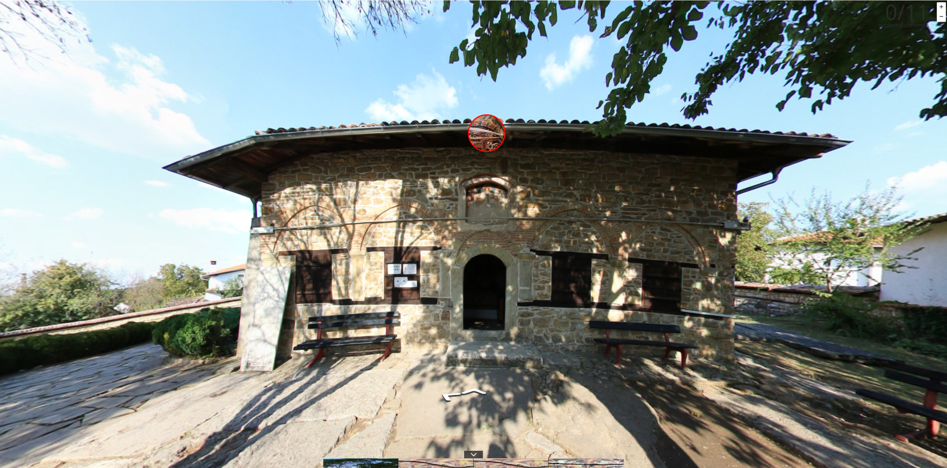
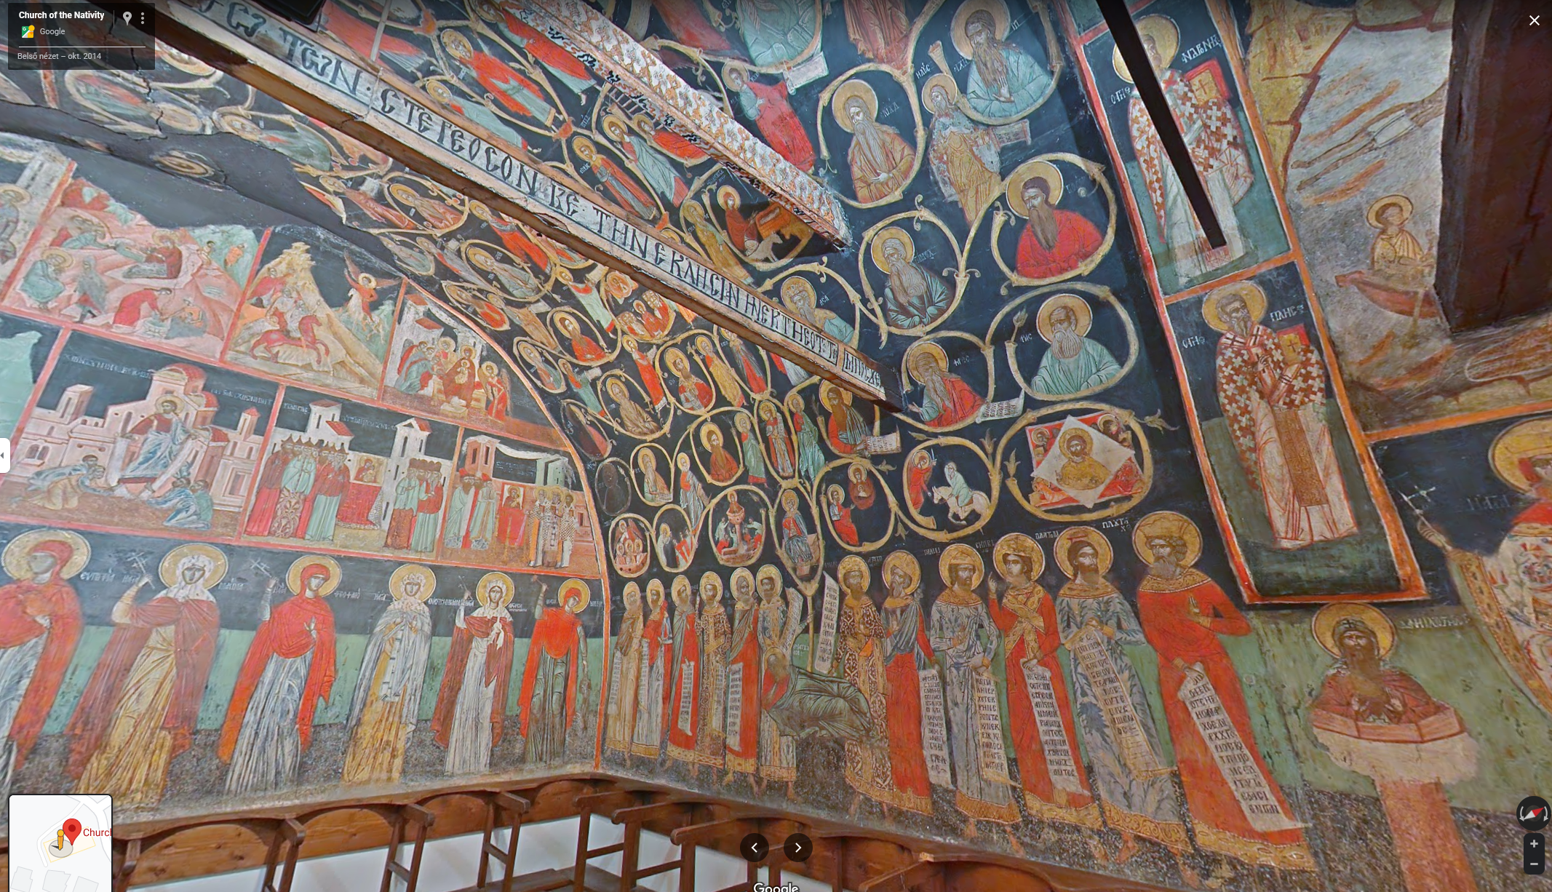
Evaluation 1
Further virtual walks on the Church of Nativity of Christ:
Official website
Virtual walk created by Google

Slide 27
Evaluation 2
The main benefits of our virtual tour solution:
high quality panorama pictures
integration with thematic database (BIDL)
own developed player that can be customised and further extended
hotspots for various multimedia contents
multilingual

Slide 28
Conclusions and Further Plans
Virtual walk using high-resolution photo panorama view is proved to be an attractive way to present cultural and historical sites.
A methodology for creating virtual walks is developed.
Virtual walk is integrated with BIDL to provide additional information.

Slide 29
Thank you for your attention!
eLearning Department
Institute for Computer Science and Control (SZTAKI)
H-1111 Budapest, Lágymányosi u. 11.
Phone: +36 1 279 6191
Fax: +36 1 209 5269
e-mail: markus.zsolt@sztaki.hu
Web: http://www.sztaki.hu/elearning

