Slide 1
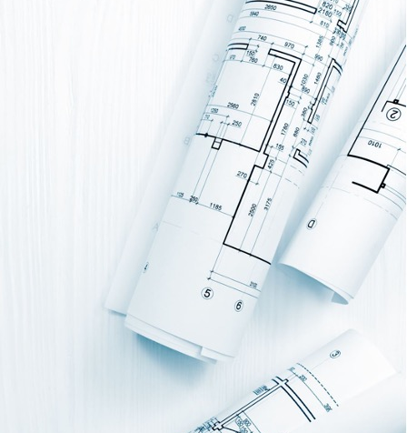
Segmentation of Floorplans and Heritage site
Approach to an unbalanced dataset
Sujith Gunjur Umapathy
(sujithgunjur.umapathy@stud.srh-campus-berlin.de )
Prof. Dr. Alexander I. Iliev
(ailiev@berkeley.edu)

Slide 2
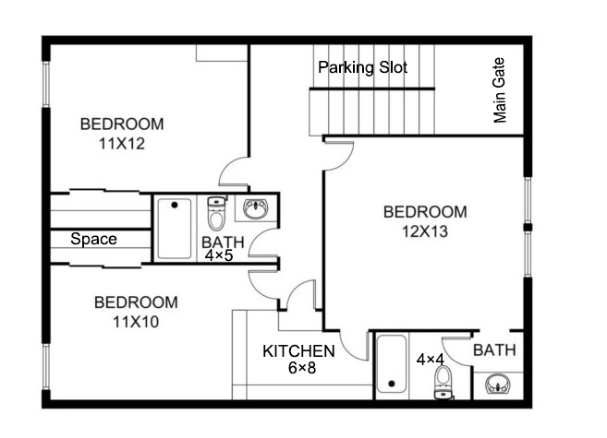
Semantic Segmentation
Semantic Segmentation is basically the task of classifying each pixel of an image into a particular class.
A class can be anything, that we are interested in within an image.
Eg: Walls, Rooms, Doors, Window
Does not differentiate pixels of different instances, if it belongs to the same class
Eg: Wall Type A, Wall Type B -> Wall class
After wall Segmentation

Slide 3
Segmenting the Floor Plan
Helps in identifying where the important elements are present in a floorplan (i.e. Walls, Doors,Windows, Text elements like measurements & description)
Primarily helps us in the process of digitizing the floorplan (vector image), which gives a high degree of freedom and operational flexibility
[Fig: Raster image vs Vector Image]

Slide 4
Benefits of Segmenting the Floorplan
Helps in converting floorplans to digital assets
Using Deep Learning algorithms, we can identify walls, doors and windows automatically and individually resulting in the following advantages:
Does all the heavy lifting (i.e. Digitalization, Planning, and Estimations on a floorplan) result in cost reduction.
* Room Size Estimation
* Optimal positioning for lighting and electrical switches
* Electrical linings be determined.

Slide 5
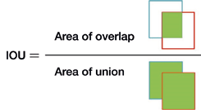
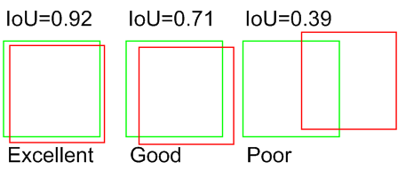
Measure of Performance – IoU Score
IoU basically stands for Intersection over Union
It is a good metric to measure the overlap between an original image & its prediction
If the prediction is completely correct, then IoU = 1
If the prediction is completely wrong, the IoU = 0, which means there is no overlap at all

Slide 6
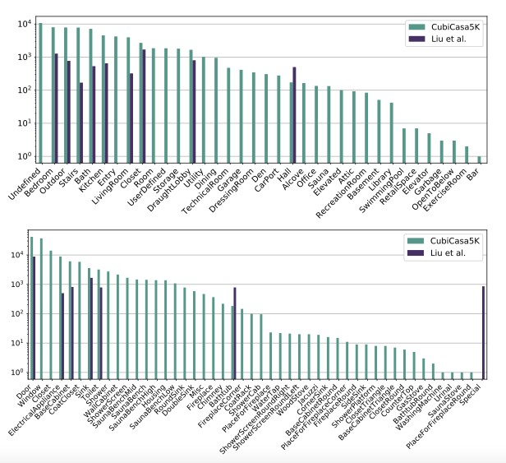
Floorplan Dataset & its Distribution
 | (Dodge, Xu, & Stenger, 2017) | (de las Heras, Terrades, Robles, & S’anchez, 2015) | (Lin, Goyal, Girshick, He, & Dollár, 2017) | (Kalervo, Ylioinas, Häikiö, Karhu, & Kannala, 2019)
Images | 500 | 122 | 815 | 5000
Room | NA | 1320 | 7466 | 68877
Wall | NA | 6089 | 16139 | 147024
Windows/ Doors/ Icons | NA | 2345 | 15040 | 136676
Comparison against potential datasets

Slide 7
Challenges
CubicCasa 5K dataset is an unbalanced dataset
Class labels like doors & windows have more instances than other class labels
Results in a model drift towards class labels of higher instances
Important classes like rooms are deprioritized
Overall the IoU score is affected

Slide 8
Solution to Segmentation
The most popular U-Net architecture is chosen for the training process
Floorplan images are augmented to help the DL model train better and generalize
Floorplans are tiled to a block size of 256 x 256 px
Loss is computed using the combined Focal loss and Jaccard Loss

Slide 9
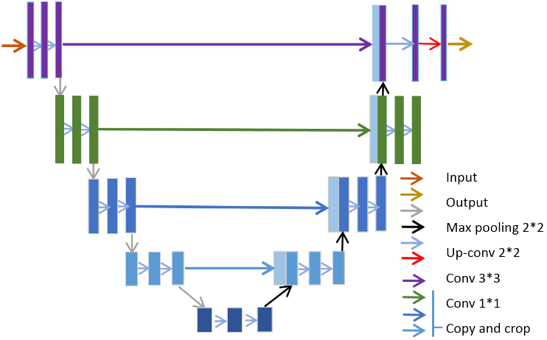
Evaluating the model
Read the image
Tile the image – 256x256
Pass tile image through U-Net architecture
Receive tiled predictions
Perform prediction on each tile
Merge the tile to original Image size

Slide 10
Results
Train Mean IoU | Validation Mean IoU | Test Mean IoU
84% * | 82% | 81%
Model | Recall | Precision
Dataset - Rooms | 80.9 | 78.5
CubiCasa 5K (Kalervo, 2019) | 90.0 | 87.6
Ours | 91.3 | 85
* Weighted 4 class – Rooms, Walls, Doors and Windows

Slide 11
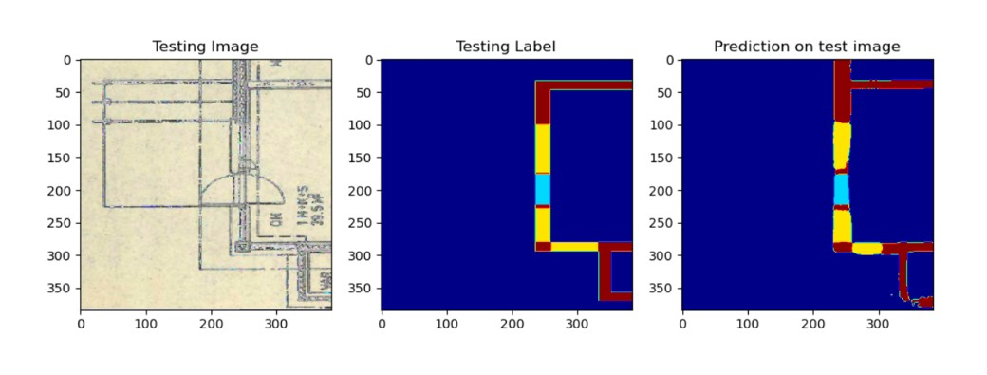
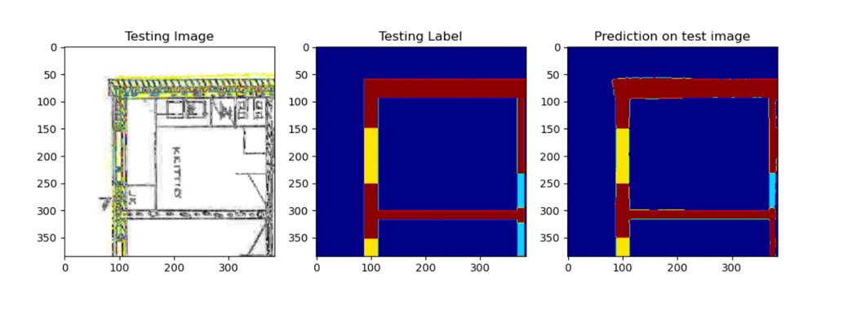
Results

Slide 12
Results
GT
Prediction
GT
Prediction

Slide 13
Summary
Unbalanced dataset can have adverserial affect during training causing a model drift
Balancing class labels can be done by either reducing the dataset size or by combining loss functions
Loss functions can consider the imbalance factor and penalise accordingly
Jaccard Loss + Focal loss was proved to be effective in minimising the dataset imbalance issue on CubiCasa 5K dataset

Slide 14
Thank You

