Slide 1
Digital Imaging Techniques in Archaeometry: the Case of an Ancient Crucifixion Icon
Magdelena Stoyanova^{1[0000-0003-4973-5991]}, Diego Stoyanov², Lilia Pavlova³
¹ Ca’ Foscari University, Centro Interdisciplinare di Studi Balcanici ed Internazionali,Venice, Italy
² University of Padova, Faculty of Engineering, Padova, Italy
³ Laboratory of Telematics, Sofia, Bulgaria
mgstoyanova@hotmail.it, pavlova.lilia@gmail.com
Notes:
This paper illustrates the application of an appositely elaborated ontology-based knowledge model dedicated to digitization of Byzantine and post Byzantine painting and functional to archaeometric and conservation purposes. It is intended to assist authentication, attribution and dating as well as reasoning through defined semantic data collected from digital multimodal & multidimensional images which describe the physical and chemical characteristics of the studied objects.

Slide 2
Workflow diagram
Notes:
In the present case, with the help of particular digital visualizations an ancient Crucifixion icon has been studied by optical microscopy, macro photography in VIS/raking light, ultraviolet fluorescence, infrared reflectography and X-ray. Technically relevant parameters and suitable algorithms have been selected in a proper sequence to segment the studied images into meaningful elements functional to the attribution of the icon through analysis of the employed materials and techniques.
The diagnostic campaign conducted on the icon has been limited to spectral analysis by imaging techniques. The experiments aimed to study the reaction of gesso, paint and varnish layers together as well as separately to UV, IR and XR radiation. All information necessary to the study (analogue pictures, texts, reference tables as for the spectral investigation etc.) has also been digitized. Large files have been reduced and transformed to formats that allow to visualize them contemporary by an internal image viewer.

Slide 3
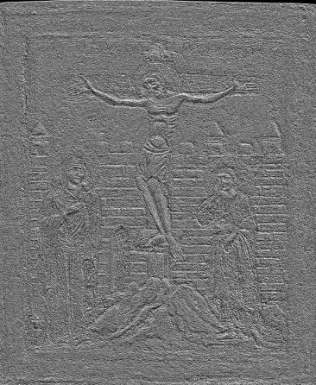
Digital Preprocessing
VIS monochrome shadowed (left) and XR shadowed (right)
Notes:
All images have been rendered more legible by denoising, histogram adaptation, selection of the color palette and color inversion, by monochromatic filtering of the visible light and chromatic transformation of halftone images, morphological filtration, edge detection, opportune highlighting or shading of the surface relief . Besides the “moveable virtual light source”, the “color mapping” , “layer-structure”, “transparency” and “edge filter” functionalities have been of great efficacy for enhancing the visibility of the processed images, particularly regarding their intensity, color, density, homogeneity; the presence of dark or clear areas and lines which are of primary importance for the evaluation of the chemo-physical properties of the artifact.
Opportune highlighting or shading of the surface relief is comparable to raking light photography in its capacity to emphasize details and moreover, as seen on the pictures here, it has the advantage of producing shadings from any angle anytime

Slide 4
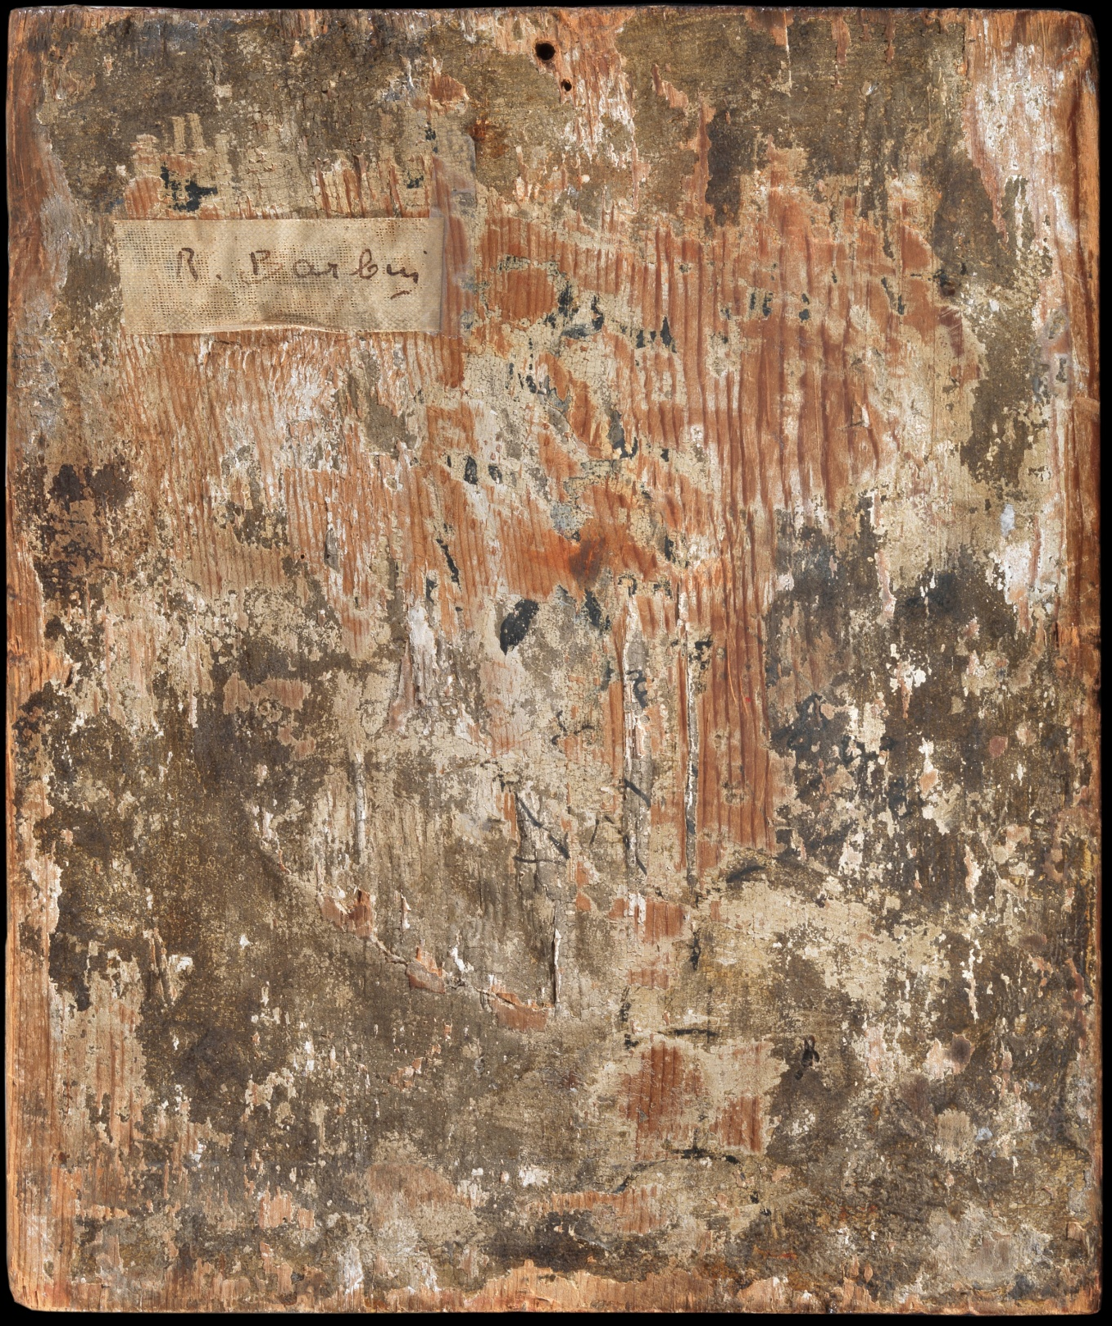
The Artifact
Notes:
The object of this case study is an ancient panel painting actually in the Ferdinando Mazzei collection (Rome),depicting the Crucifixion, about whose place of origin, date and vicissitudes there is any information.
The whole representation is denoted by profound dichotomy between the iconographic composition, on the one hand, and the technical realization of the painting and its ornamentation – on the other. For example, at the foot of the cross, in front of the Virgin, we do not find Longinus, as traditional, but a figure that would be compactable with that of John the Theologian, however, of such feminine traits as to confuse him with Mary Magdalene. That this may not be authentic springs from the relief of the pictorial layer in raking light. Besides, from the naked eye observation is visible that the wooden support should be much older than the style of painting, indicative for the religious art of the reformed Catholic Church (17th – 18th centuries) does presume. At that time, throughout all the Latin area the wooden supports had long since been replaced from textile fabrics and the egg tempera - from oil painting, whose invention mid 15th c. is attributed to the great Flemish painter Jan van Eyck.

Slide 5
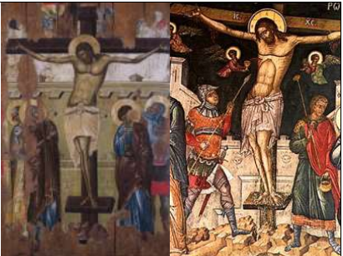
a) Unknown painter , Crucifixion 1272-1275, Napoli, S. Domenico Maggiore; b) Byzantine and Italian (Venetian) masters (?) The Bessarione Reliquary, 14th – 18th c. c) Bilateral icon with Crist and the Crucifixion. S. Stefan church, Nessebar, 14th c, tempera on wood, gilding, mm 1438 х 997; d) Crucifixion, fresco in the Great Lavra, Athos, 1535.
Notes:
Embarrassing are as well the flattened geometric and underlined in relief shapes of the stones that, with a sort of hyperrealism, depict the wall of Jerusalem in the background. And not least, the only preserved inscription on the painting, JNRJ (Jesus Nazarenus Rex Judaeorum) is in Latin, while on the back side we can see the typical cross dating formula in Greek, as used by post Byzantine iconographers.

Slide 6
Fresco in the S. Nicola church at Varoscia, Prilep (Macedonia), 1298-99; Emmanuel Lampardos, Crucifixion icon , Hermitage of San Petersburg, first half of the 17° c.
Notes:
Other perplexities arise from the fact that under Golgotha one does not see the usual for Orthodox iconography, module with the skull of Adam, the rivers of paradise and the woods of which the cross was built. These elements not rarely are encountered even in Italian Renaissance art.

Slide 7
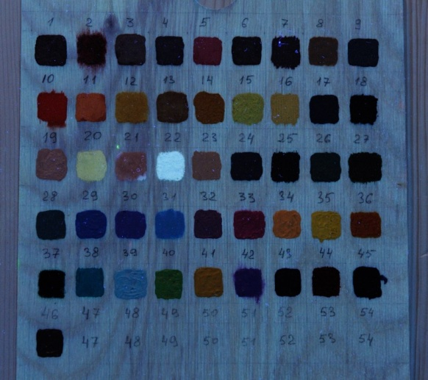
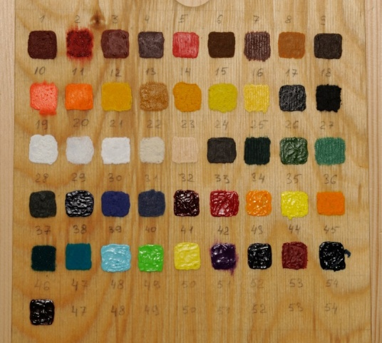
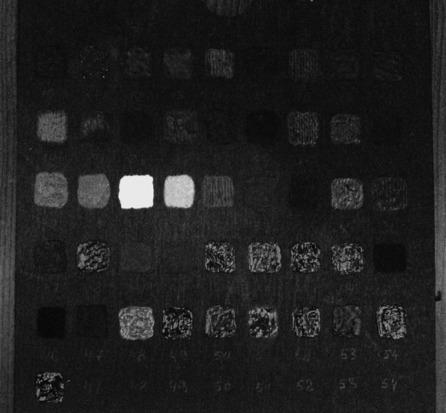
Study in Ultra Violet Fluorescence
Notes:
The investigation in the UV register had the purpose to explore :
- the reaction of ground, paint and varnish layers together as well as separately to UV rays on base of intensity, colour, density, homogeneity as indicators about the status of conservation (about losses and restorations);
- the Characteristics of the protective layer: the presence of dark, resp. clear areas as sign of posterior interventions; deposits or missing protective layer ;
the reaction of gesso, paint and varnish layers together as well as separately to UV radiation as indicators about the pigment's composition (of white, red, blue and yellow mineral pigments) ;
- presence of archaeometric indicators as, for example, of glues, egg, old Pb white, cinnabar or madder;
- presence of faded inscriptions made with iron-gall inks or with Hg, Pb, Cr and Fe containing pigments;
- the position in-depth of the inscriptions (under the varnish, between two layers of varnish, over them or on their place; over restored parts).
- the dependence between the chemical nature of the materials considering also their age and the response they give to UV rays at determined lengths.

Slide 8
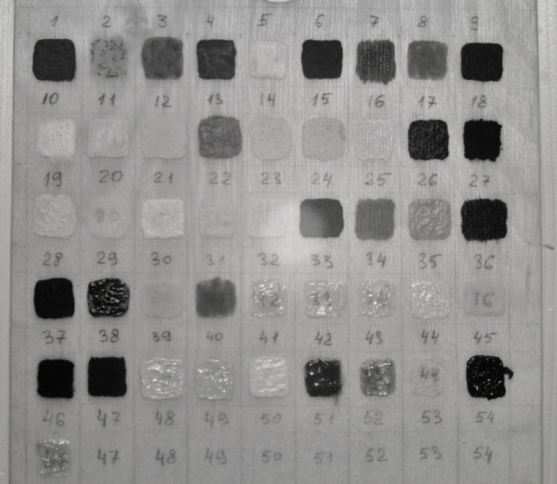
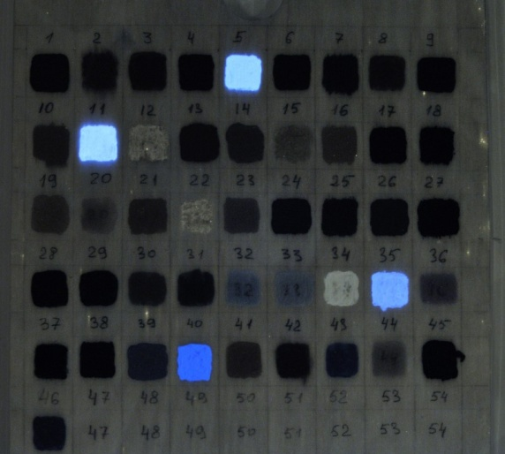
Study in the Infra Red Register
IRr at 950-1100 nm
Notes:
The underlying layers were studied by infrared shooting at 950-1100 nm and infrared radiation between 1650 and 1800 nm. The investigation in the IR register had to learn more about the underlying layers of the painting, eventual modifications in the composition (pentimenti); to recognize the preparatory design: a hidden element, of particular importance in the attribution and dating, and to collect eventually data on the chemical composition of employed materials on base of already registered issues , for example make distinction between carbon, iron, copper cadmium containing yellow and red pigments; if based on oil or shell lack

Slide 9
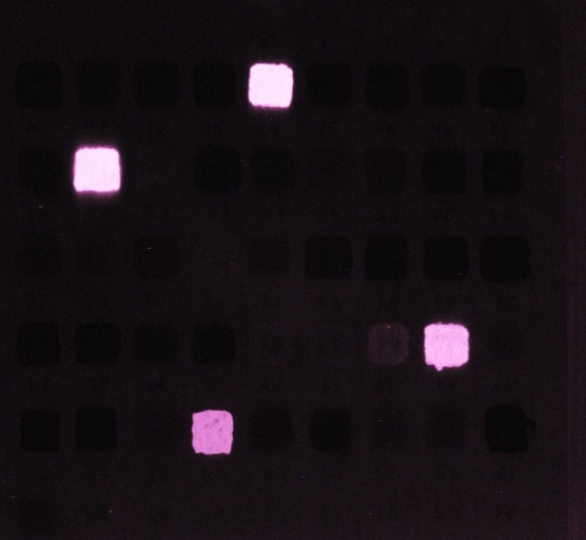
IRr at 1650-1800 nm
Notes:
The IR investigation helped to identify the extent of the various modifications to which the original painting has been subjected over the centuries, and to define their character. These touch-ups match especially the design of the anatomical parts and the cross. IRr also highlighted a widespread crackle (in shape of cells, in the central and lower part of the table), and fragments of very articulated drawing - in the mantle of Magdalene, for example, made by brush with carbon containing substance and visible as black lines. Under the inscription JNRJ appeared another, difficult to read, however compatible with the typical for the Greek - Byzantine Crucifixions «βαζιλιας». Under the canopy of the pinnacle to the right of the cross took shape a small figure of a person raising a cross (perhaps the converted to Christ soldier Longinus).

Slide 10
Study in the XR Register
The normal (left) and inverted (right) radiography
Notes:
The examination of the radiographic image had to study the support (e.g. wood specie(s), structure, density and age; presence of living worms, water infiltrations, wood oxidation, presence of metal particles), the process of the painting creation , changes in composition, underlying paintings, pigment's composition (of white, red, blue and yellow mineral pigments, for example presence of Pb, of quicksilver (in the bolus for gilding)), of gesso integrations, the existence of older restorations, etc. Together with the mapping of original painting extension and its status of conservation, it helped the solution of the authentication problem and to build an idea of what the original composition was like. The inverted radiography had to help the enhancement of details that rest invisible because optically dominated by the background.

Slide 11
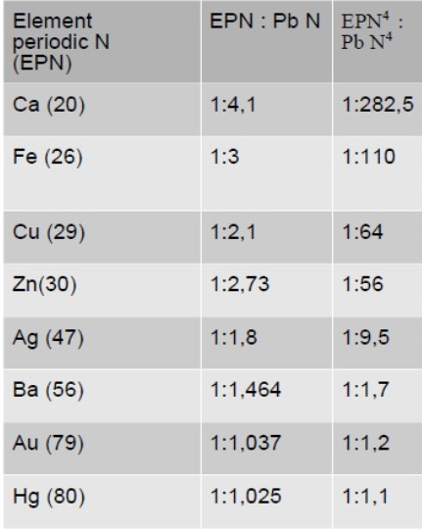
Close-up of the lower right corner of the radiography
Notes:
The XR close-up of the lower right corner showed that the engraved and gilded frame was not carved from the wood, but formed by two thin twines running parallel and prepared with glue and chalk. The edge external to the second frame of twine is characterized by a fairly coarse processing, without levcas. The individualization of the pigments without taking samples was based on the rule that the X-ray absorption of the different elements depends on the square exponent of their periodical number (as reported in the table right).

Slide 12
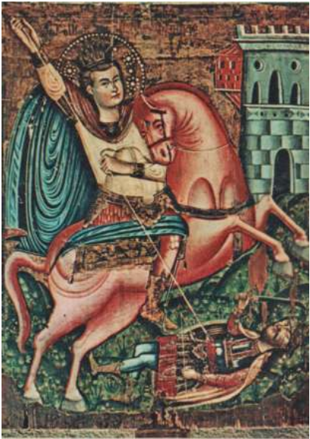
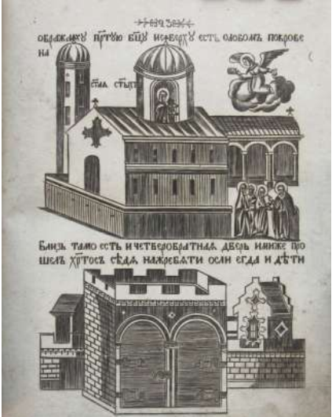
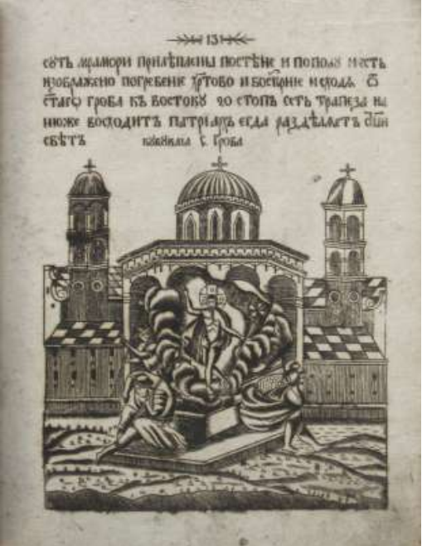
The Visible and Invisible Crucifixion: Digital Reconstruction and Attribution
H.Zefarović, left S.Demetrios, 1740 circa, GMS Novi sad; center and right: IDEM, Illustration to the Description of the Holy City of Jerusalem, 1781
Notes:
The cross-referencing of the results obtained in the course of the complex stylistic, iconographic, technical-technological and digital spectral investigation allowed the identification - without sample collection - of some of the pigments employed and of original parts under paints, thus providing substantial clues for the reconstruction of the various transformations of the original icon. The definition of their extent and date was possible mainly taking into account the differences that distinguish the Orthodox tradition from the Latin as regards the plastic construction of the figures, the type of perspective, the painting technique, and the use of specific materials. Thanks to the abundance of data of archaeometric value, a highly plausible periodization of the various interventions could be advanced according to which the original icon was created in post Byzantine style, with inscriptions in Greek on the verse and with the master's signature on the back. In the second phase, the pastille ornaments were added hiding the Greek name of the scene, the frames around the central field and the relief halos. On this occasion the thong of Christ was modified and in the background was introduced the now visible Jerusalem wall, with relief underlining of the stones. In the third phase, together with the touch-ups of the faces and hands with oil, the module with the skull of Adam was covered and the Greek inscription on the cross replaced with INRI. Also the maphorion of the Virgin was repainted, hiding the original, detailed design of the folds and their graphic ornamentation visible in XR.

Slide 13
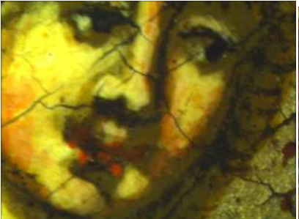
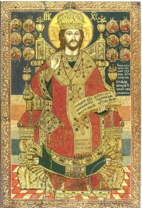
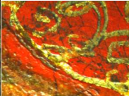
Left: George of Šarengrad, S. George killing the dragon (close-up) GMS Novi sad [n.d.];Right: Stanoje Popović, Gesù Christ with apostles in medallions, 1743; left below: detail.
Notes:
Of particular utility for the attribution of the painting has been the elemental analysis of different pigments and dyes of archaeometric importance based on their reaction to XR, UV and IR.
Other important guidelines for the reconstruction of the three phases created he documentation collected in occasion of the STSM “Spectral investigation of Serbian Baroque icons” carried out in Galerija Matica Srpska November 2014 (funded by the COST COSCH Action TD1201) where are conserved important works of post Byzantine paintings carried out in the central and western Balkans in the period among the 16th-18th c.

